Slide 1
5
INVERSE FUNCTIONS

Slide 2
5.5
Exponential Growth and Decay

Slide 3
Exponential Growth and Decay
In many natural phenomena, quantities grow or decay at a rate proportional to their size.
For instance, if y = f (t) is the number of individuals in a population of animals or bacteria at time t, then it seems reasonable to expect that the rate of growth f ′ (t) is proportional to the population f (t); that is, f ′ (t) = kf (t) for some constant k.
Indeed, under ideal conditions (unlimited environment, adequate nutrition, immunity to disease) the mathematical model given by the equation f ′ (t) = kf (t) predicts what actually happens fairly accurately.

Slide 4
Exponential Growth and Decay
Another example occurs in nuclear physics where the mass of a radioactive substance decays at a rate proportional to the mass.
In chemistry, the rate of a unimolecular first-order reaction is proportional to the concentration of the substance.
In finance, the value of a savings account with continuously compounded interest increases at a rate proportional to that value.

Slide 5
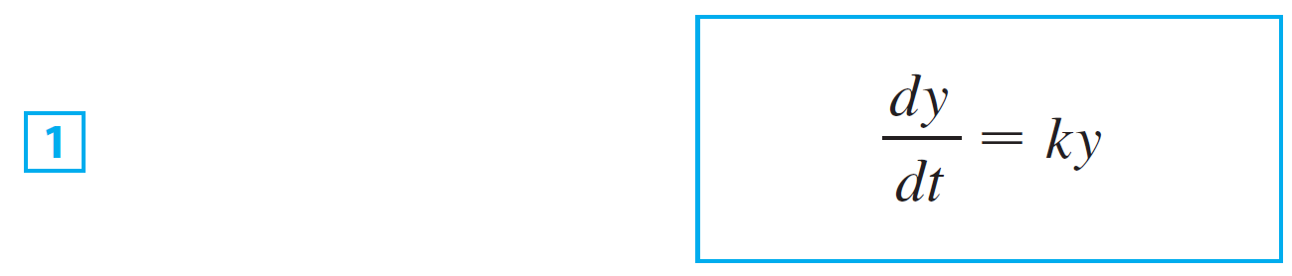
Exponential Growth and Decay
In general, if y(t) is the value of a quantity y at time t and if the rate of change of y with respect to t is proportional to its size y(t) at any time, then
where k is a constant. Equation 1 is sometimes called the law of natural growth (if k > 0) or the law of natural decay (if k < 0).
It is called a differential equation because it involves an unknown function y and its derivative dy/dt.

Slide 6
Exponential Growth and Decay
It’s not hard to think of a solution to Equation 1. This equation asks us to find a function whose derivative is a constant multiple of itself.
We have met such functions in this chapter. Any exponential function of the form y(t) = Ce^{kt}, where C is a constant, satisfies
Conversely any function that satisfies dy/dt = ky must be of the form y(t) = Ce^{kt}.

Slide 7
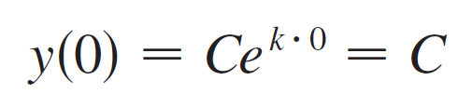
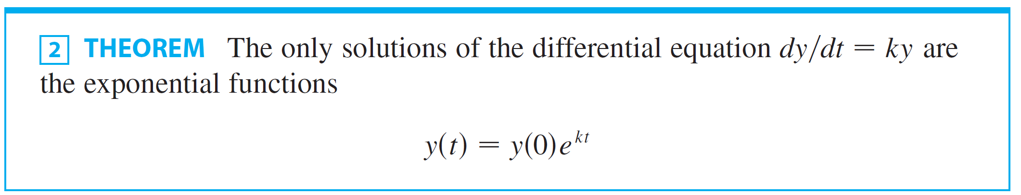
Exponential Growth and Decay
To see the significance of the constant C, we observe that
Therefore C is the initial value of the function.

Slide 8
Population Growth

Slide 9
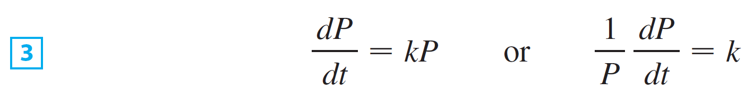
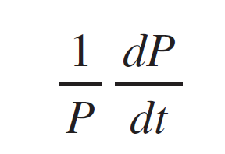
Population Growth
What is the significance of the proportionality constant k? In the context of population growth, where P(t) is the size of a population at time t, we can write
The quantity
is the growth rate divided by the population size; it is called the relative growth rate.

Slide 10


Population Growth
According to , instead of saying “the growth rate is proportional to population size” we could say “the relative growth rate is constant.”
Then says that a population with constant relative growth rate must grow exponentially.
Notice that the relative growth rate k appears as the coefficient of t in the exponential function Ce^{kt}.

Slide 11
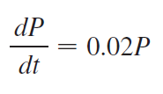

Population Growth
For instance, if
And t is measured in years, then the relative growth rate is k = 0.02 and the population grows at a relative rate of 2% per year.
If the population a time 0 is P₀ , then the expression for the population is

Slide 12
Example 1
Use the fact that the world population was 2560 million in 1950 and 3040 million in 1960 to model the population of the world in the second half of the 20th century. (Assume that the growth rate is proportional to the population size.)
What is the relative growth rate? Use the model to estimate the world population in 1993 and to predict the population in the year 2020.

Slide 13

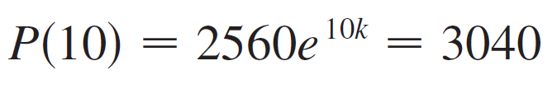
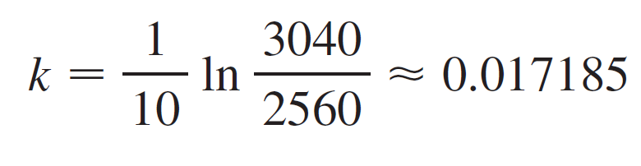
Example 1 – Solution
We measure the time t in years and let t = 0 in the year 1950. We measure the population P(t) in millions of people. Then P(0) = 2560 and P(10) = 3040.
Since we are assuming that dP/dt = kP, Theorem 2 gives

Slide 14
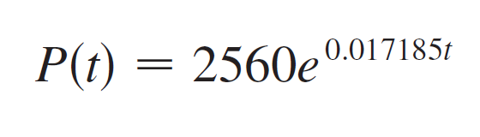
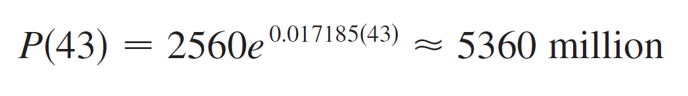
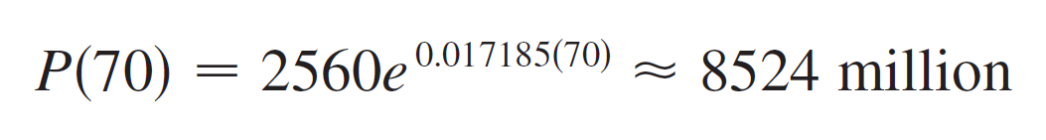
Example 1 – Solution
cont’d
The relative growth rate is about 1.7% per year and the model is
We estimate that the world population in 1993 was
The model predicts that the population in 2020 will be

Slide 15
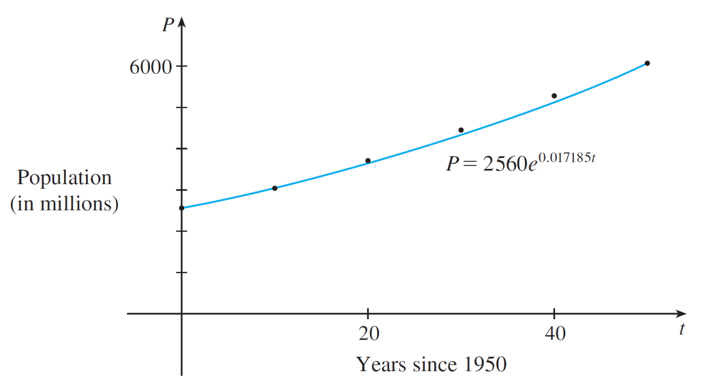
Example 1 – Solution
cont’d
The graph in Figure 1 shows that the model is fairly accurate to date (the dots represent the actual population), so the estimate for 1993 is quite reliable. But the prediction for 2020 is riskier.
A model for world population growth
in the second half of the 20th century
Figure 1

Slide 16
Radioactive Decay

Slide 17
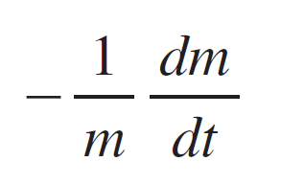
Radioactive Decay
Radioactive substances decay by spontaneously emitting radiation.
If m(t) is the mass remaining from an initial mass m₀ of the substance after time t, then the relative decay rate
has been found experimentally to be constant. (Since dm/dt is negative, the relative decay rate is positive.)

Slide 18
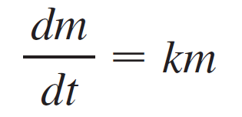
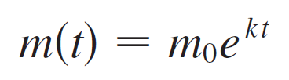
Radioactive Decay
It follows that
where k is a negative constant. In other words, radioactive substances decay at a rate proportional to the remaining mass.
This means that we can use to show that the mass decays exponentially:
Physicists express the rate of decay in terms of half-life, the time required for half of any given quantity to decay.

Slide 19

Example 2
The half-life of radium-226 ( ) is 1590 years.
(a) A sample of radium-226 has a mass of 100 mg. Find a formula for the mass of that remains after t years.
(b) Find the mass after 1000 years correct to the nearest milligram.
(c) When will the mass be reduced to 30 mg?

Slide 20
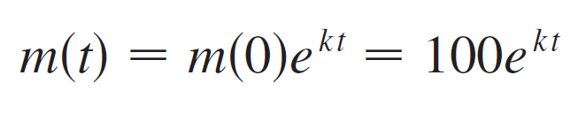
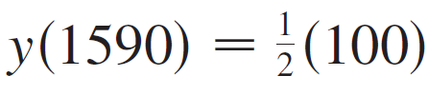
Example 2 – Solution
SOLUTION:
Let m(t) be the mass of radium-226 (in milligrams) that remains after t years.
Then dm/dt = km and y(0) = 100, so gives
In order to determine the value of k, we use the fact that
.

Slide 21
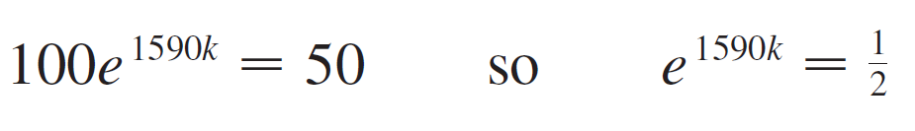
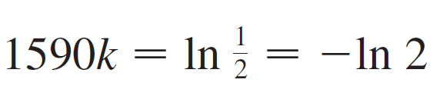
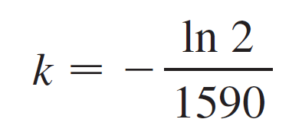
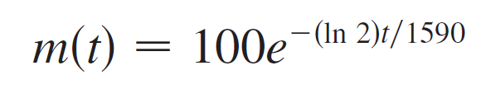

Example 2 – Solution
cont’d
Thus
and
Therefore
We could use the fact that e^{ln} ² = 2 to write the expression for m(t) in the alternative form

Slide 22
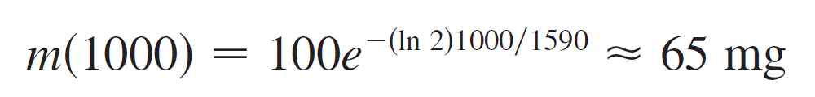
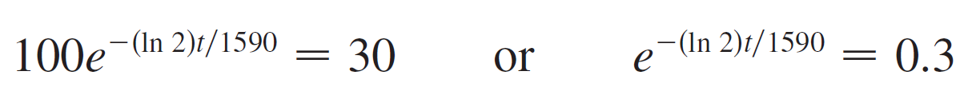
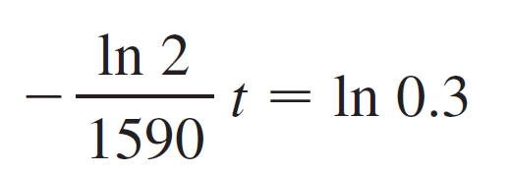
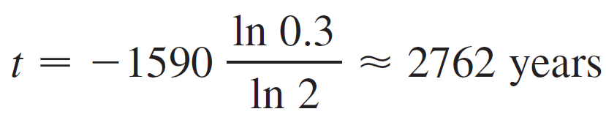
Example 2 – Solution
cont’d
(b) The mass after 1000 years is
(c) We want to find the value of t such that m(t) = 30, that
is,
We solve this equation for t by taking the natural logarithm of both sides:
Thus

Slide 23
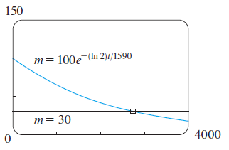
Radioactive Decay
As we check our work in Example 2, we use a graphing
device to draw the graph of m (t) in Figure 2 together with
the horizontal line m = 30.
These curves intersect when t ≈ 2800, and this agrees with
the answer to part (c).
Figure 2

Slide 24
Newton’s Law of Cooling

Slide 25
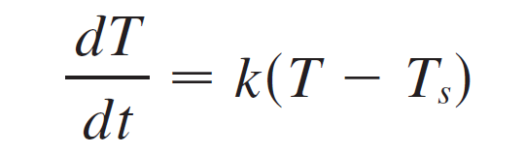
Newton’s Law of Cooling
Newton’s Law of Cooling states that the rate of cooling of an object is proportional to the temperature difference between the object and its surroundings, provided that this difference is not too large. (This law also applies to warming.)
If we let T(t) be the temperature of the object at time t and T_{s} be the temperature of the surroundings, then we can formulate Newton’s Law of Cooling as a differential equation:
where k is a constant.

Slide 26
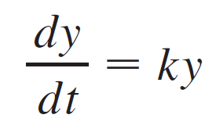
Newton’s Law of Cooling
This equation is not quite the same as Equation 1, so we make the change of variable y(t) = T(t) – T_{s}.
Because T_{s} is constant, we have y′(t) = T′(t) and so the equation becomes
We can then use to find an expression for y, from which we can find T.

Slide 27
Example 3
A bottle of soda pop at room temperature (72°F) is placed in a refrigerator where the temperature is 44°F.
After half an hour the soda pop has cooled to 61°F.
(a) What is the temperature of the soda pop after another half hour?
(b) How long does it take for the soda pop to cool to 50°F?

Slide 28
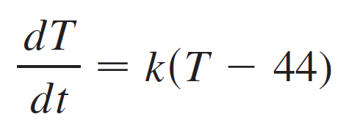
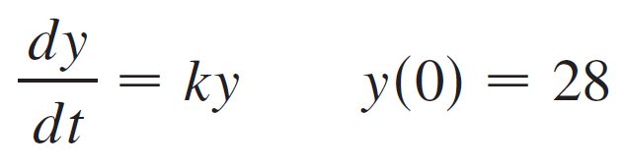
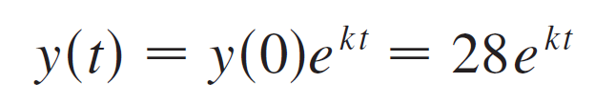
Example 3 – Solution
(a) Let T(t) be the temperature of the soda after t minutes. The surrounding temperature is T_{s} = 44°F, so Newton’s Law of Cooling states that
If we let y = T – 44, then y(0) = T(0) – 44 = 72 – 44 = 28, so y satisfies
and by we have

Slide 29
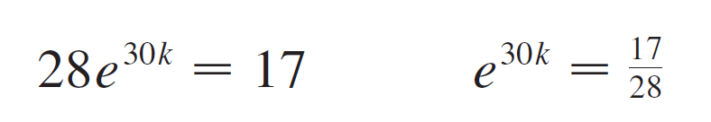
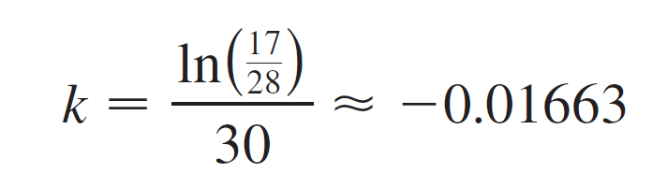
Example 3 – Solution
cont’d
We are given that T(30) = 61, so y(30) = 61 – 44 = 17 and
Taking logarithms, we have

Slide 30
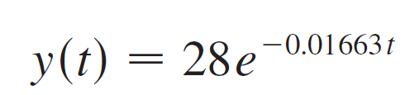
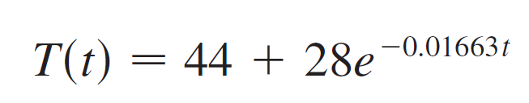
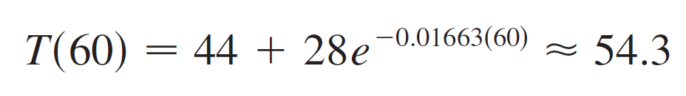
Example 3 – Solution
cont’d
Thus
So after another half hour the pop has cooled to about 54°F.

Slide 31
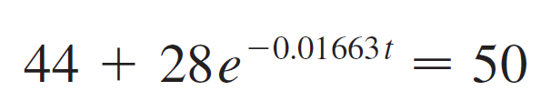

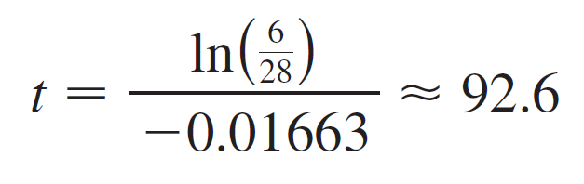
Example 3 – Solution
cont’d
(b) We have T(t) = 50 when
The pop cools to 50°F after about 1 hour 33 minutes.

Slide 32

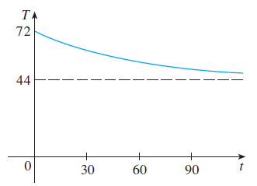
Newton’s Law of Cooling
Notice that in Example 3, we have
which is to be expected. The graph of the temperature
function is shown in Figure 3.
Figure 3

Slide 33
Continuously Compounded
Interest

Slide 34
Example 4
If $1000 is invested at 6% interest, compounded annually, then after 1 year the investment is worth $1000(1.06) = $1060, after 2 years it’s worth $[1000(1.06)]1.06 = $1123.60, and after t years it’s worth $1000(1.06)^{t}.
In general, if an amount A₀ is invested at an interest rate r (r = 0.06 in this example), then after t years it’s worth A₀(1 + r)^{t}.

Slide 35
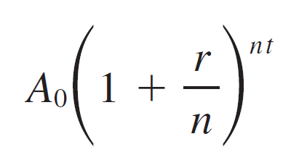
Example 4
cont’d
Usually, however, interest is compounded more frequently, say, n times a year.
Then in each compounding period the interest rate is r/n and there are nt compounding periods in t years, so the value of the investment is

Slide 36
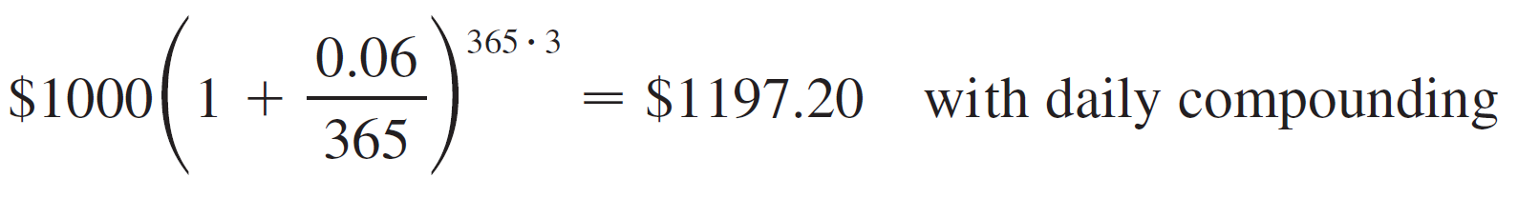
Example 4
cont’d
For instance, after 3 years at 6% interest a $1000 investment will be worth

Slide 37
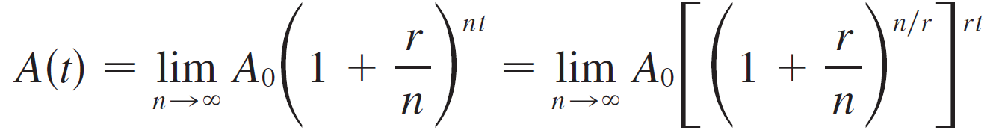
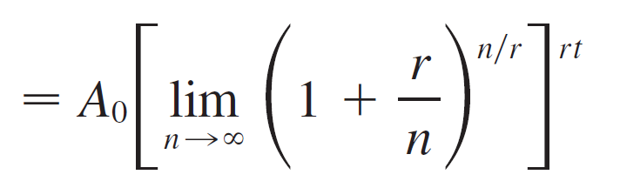
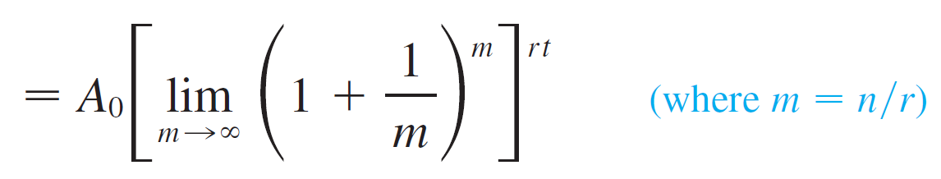
Example 4
cont’d
You can see that the interest paid increases as the number of compounding periods (n) increases.
If we let n → ∞, then we will be compounding the interest continuously and the value of the investment will be

Slide 38

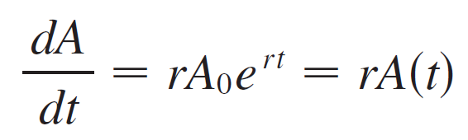
Example 4
cont’d
But the limit in this expression is equal to the number e.
So with continuous compounding of interest at interest rate r, the amount after t years is
If we differentiate this equation, we get
which says that, with continuous compounding of interest, the rate of increase of an investment is proportional to its size.

Slide 39
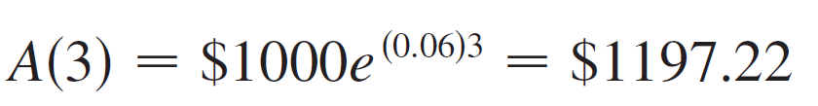
Example 4
cont’d
Returning to the example of $1000 invested for 3 years at 6% interest, we see that with continuous compounding of interest the value of the investment will be
Notice how close this is to the amount we calculated for daily compounding, $1197.20.
But the amount is easier to compute if we use continuous compounding.

